Slide 1

Threat Shield - your Gen AI enabled vulnerability analyzer

Slide 2

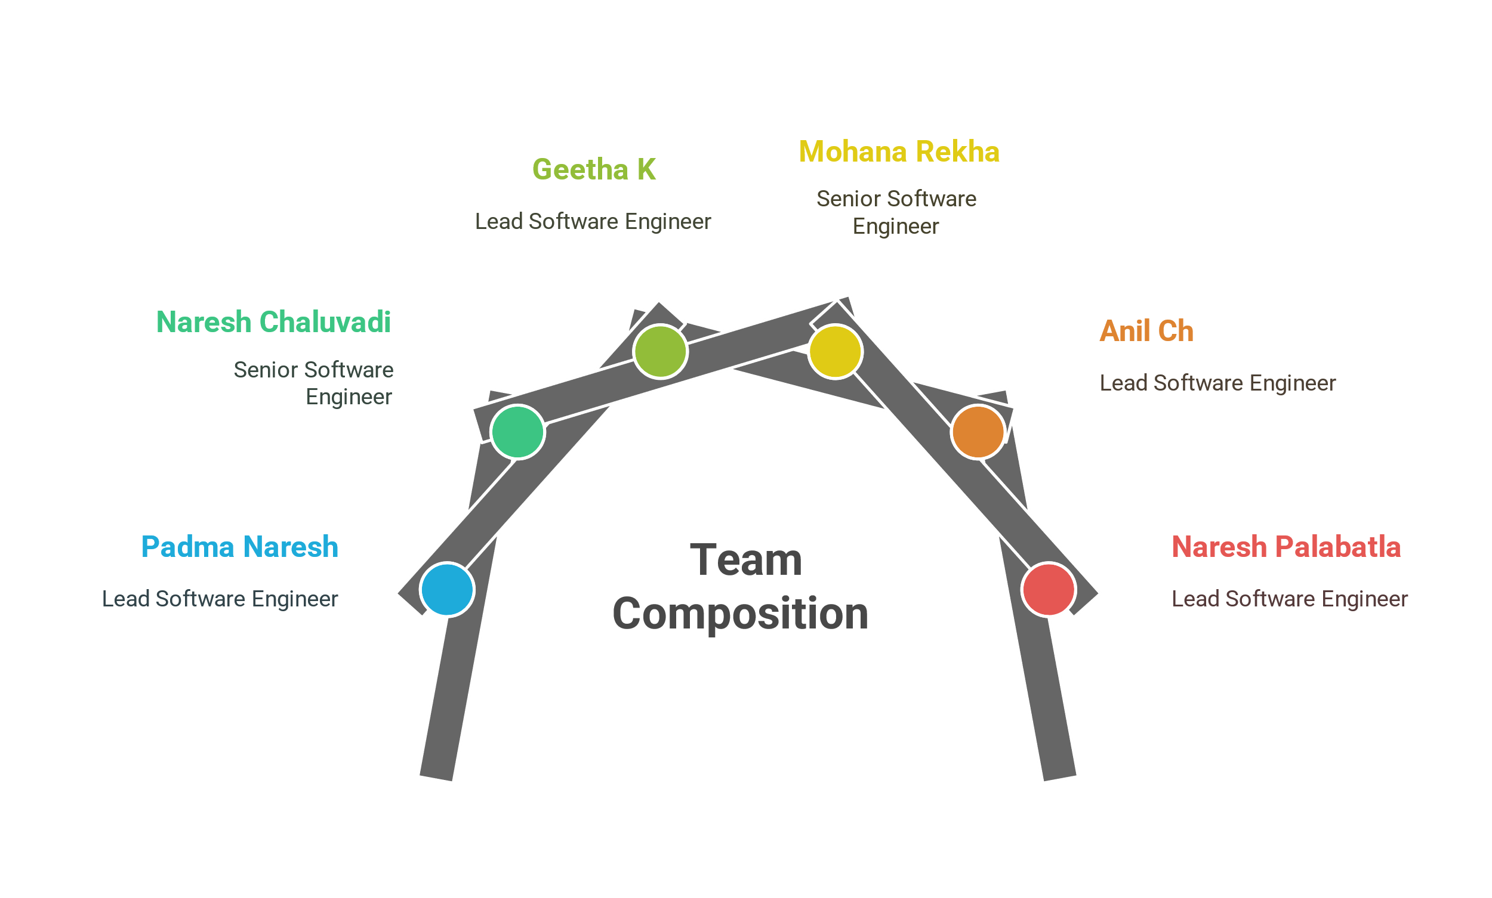
Team Threat Shielders

Slide 3










Design
Integrations Layer
Agentic Layer
Inject Source Code
Tachyon API
context
prompt
OWASP Top 10 Wells Fargo Scan Reports
< / > Context
response
response
Actions
User
File System
Llama(70B)
Issues
Observations
Web Layer
Model Layer

Slide 4
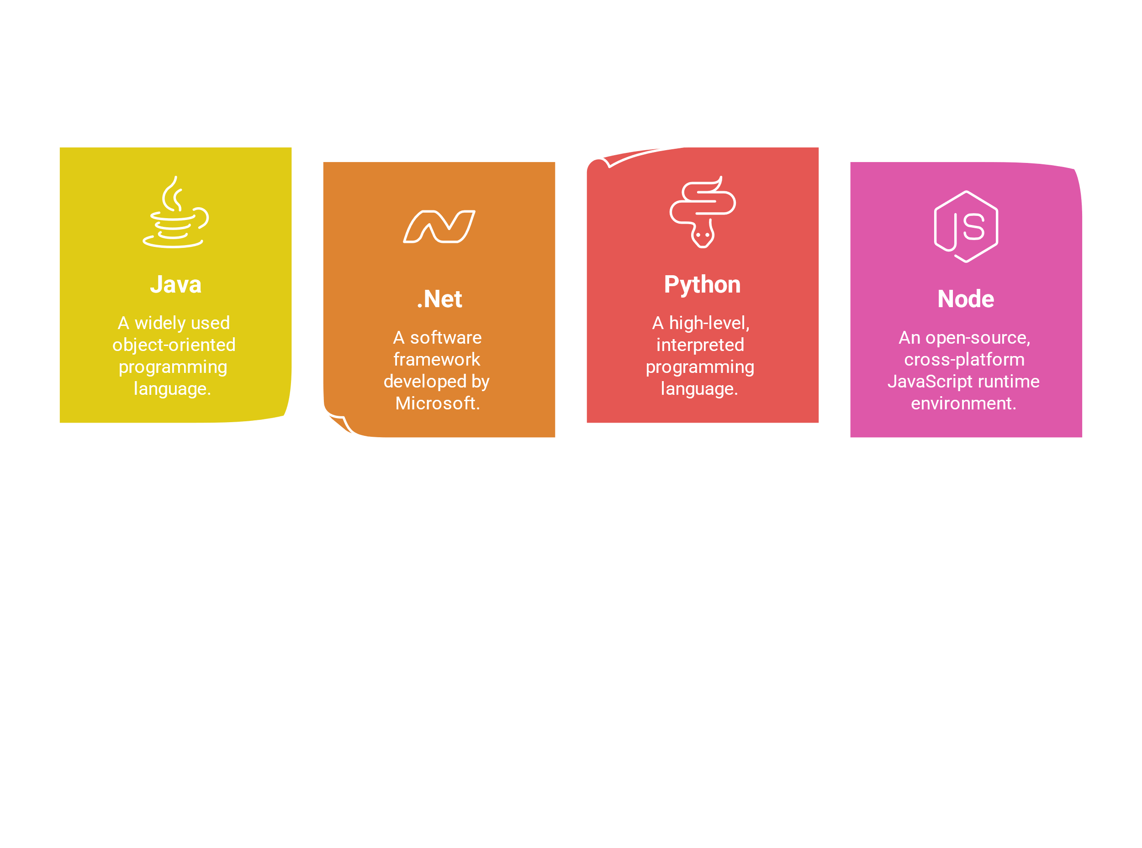
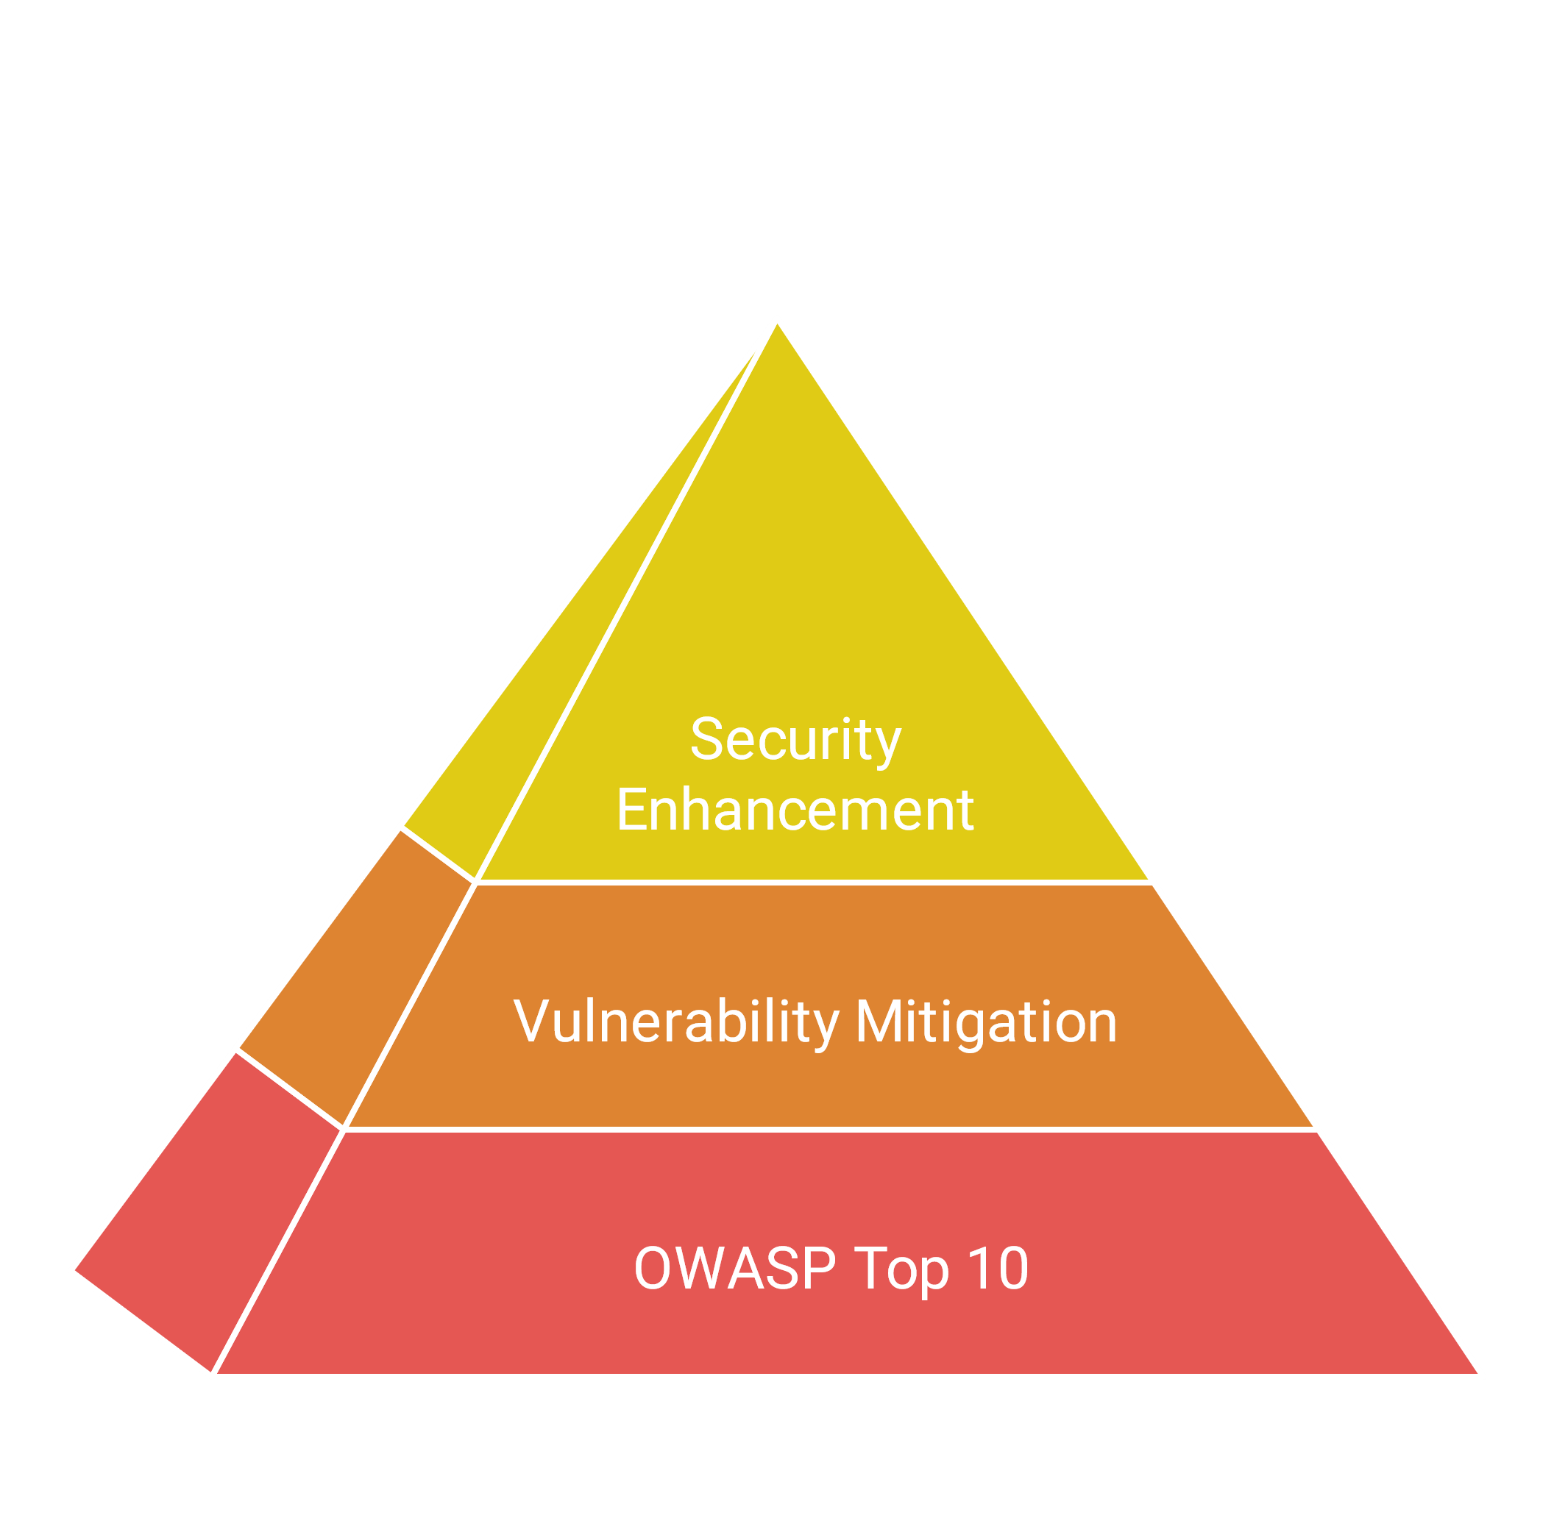
Capabilities

Slide 5
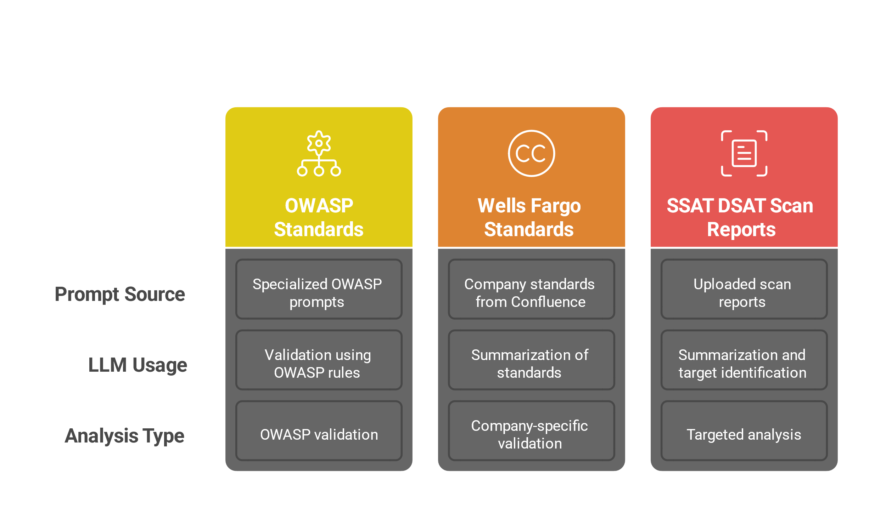
Analysis Engine
OWASP Standards Analysis:
Uses specialized OWASP prompts Sends each source file to LLM with OWASP validation rules Wells Fargo Coding Standards Analysis:
Retrieves company standards from Confluence Uses OpenAI to summarize standards Creates specialized prompts for company-specific validation
Scan Reports Analysis: Processes uploaded scan reports LLM summarizes reports and identifies target files Performs targeted analysis based on scan findings

Slide 6
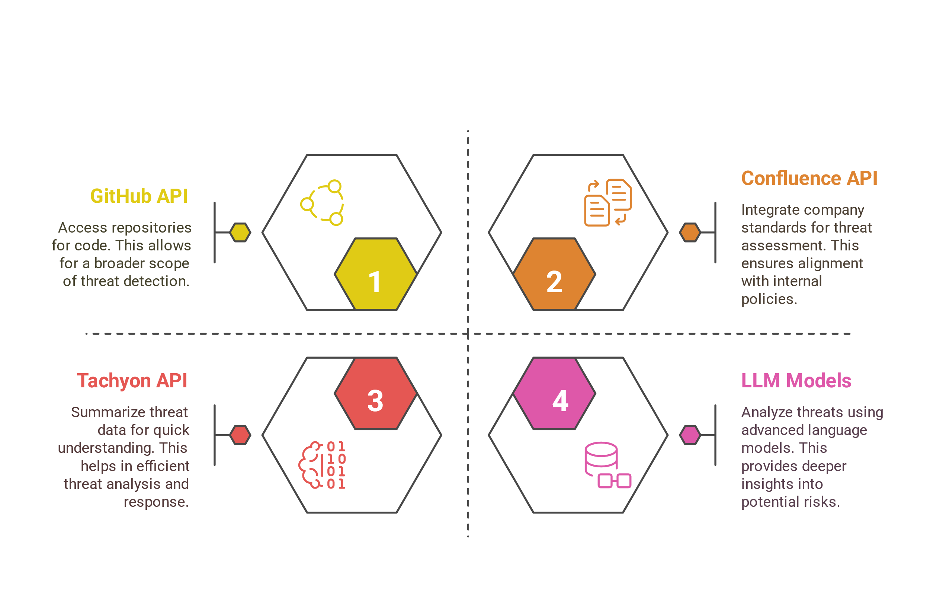
External Integrations

Slide 7
Home Page

Slide 8
Dashboard

Slide 9
Dashboard [light]

Slide 10
Dashboard [Continued]

Slide 11
Dashboard [Continued]

Slide 12
Dashboard Chatbot

Slide 13
Metrics [Continued]

Slide 14
Metrics Chatbot

Slide 15
Metrics Chatbot [continued]

Slide 16
Incidents

Slide 17
Incidents Chatbot

Slide 18





Advantages
Proactive Issue Detection
Efficient Incident Resolution Management
Knowledge Integration
Scalability
Automation

Slide 19
Thank you
“Empowering Platforms with AI Intelligence”

